Slide 1
Gamedev case study
Grass Rendering & Procedural Generation
Speaker notes in green boxes

Slide 2
Why Grass?
Gamedev programming is a weird mashup of a bunch of other fields, for ex: math (linear, geometry, statistics), physics (optics, ridig-body, soft-body, acoustic), theoretical CS, computer engineering (non-PC architectures, signal processing), AI
In more clearly defined roles:
Graphics
Animation
Gameplay/AI
Tools/generalist
Audio
Physics
System
UI
Network
Gamedev is huge
Picking one thing and diving into it
Hobby/AAA

Slide 3
Why Grass?
Where does it fit in the gamedev landscape?
Classification (grass rendering): Realtime -> Rendering -> Foliage/Animation
Classification (grass procedural generation): Offline -> Procedural/Statistical -> Terrain/ Distribution/Storage
Representative of a class of problems unique to game development:
Real-time simulation (of semi-natural phenomena)
Strict performance budget
Over-arching visual or design goals
Rabbit hole
Most things in game development are exciting rabbit holes (as far as resources allow)
Subtle but impactful visual element (http://www.eddietree.com/grass)
Master’s thesis
1st person or 3rd person perspective – occupies a large portion of the screen

Slide 4
Rendering in a nutshell
2 objects at your disposal:
Meshes
Textures
3 operations at your disposal:
Draw mesh
Vertex shaders
Pixel shaders

Slide 5
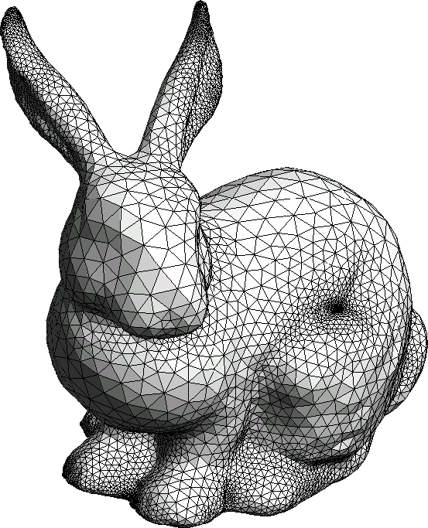
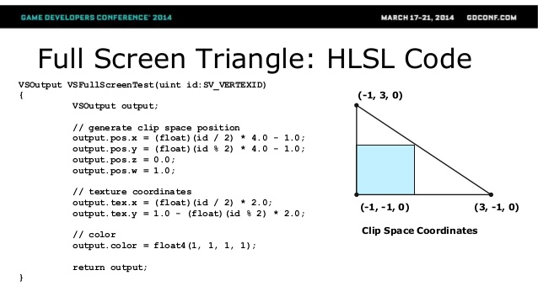
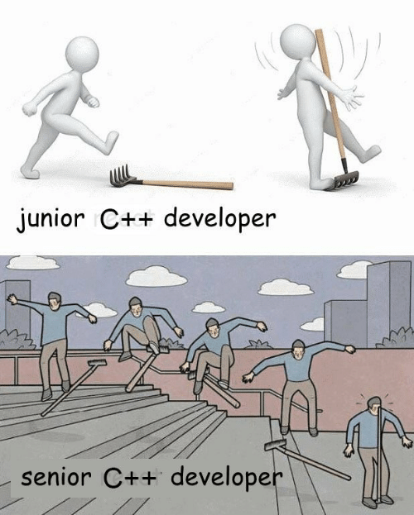

Rendering in a nutshell
Mesh (set of triangles):
Texture (fancy 2D array of pixels):
Basically any image would be considered a texture
Pixel has 4 components (red, green, blue, transparency)
Remember, can only draw meshes so to draw an image onscreen you need to use a mesh still

Slide 6
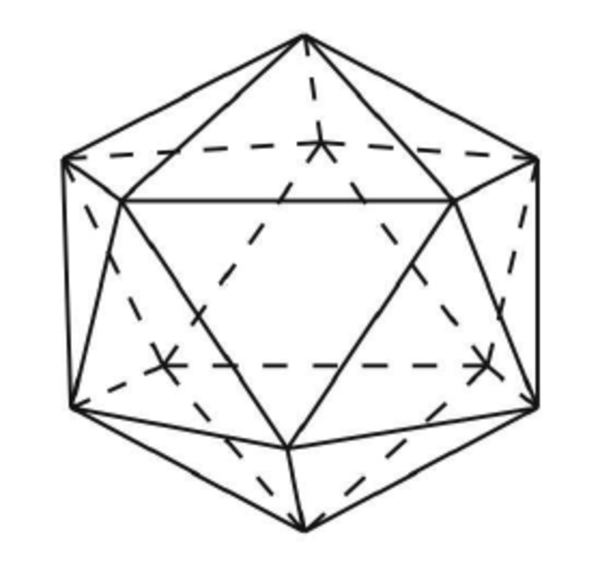
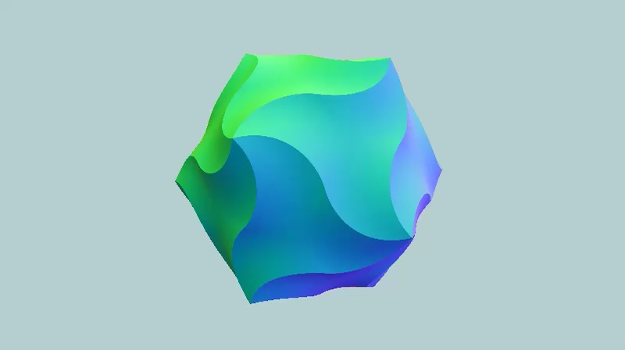
Rendering in a nutshell
Vertex shaders:
Modify mesh points before they’re rendered
Ex:
Pixel shaders:
Modify pixels as they’re rendered
Ex:
Lighting (using angle & distance to lights)
Full-screen effects (color grading)
Any kind of character animation – vertex shader
Vertex = shape, pixel = how to fill it in

Slide 7
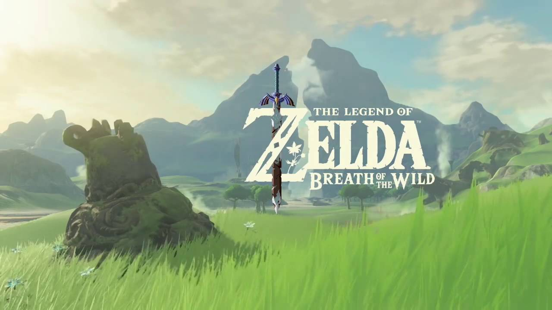
Example: Breath of the wild
https://youtu.be/80CG55wl5WE?t=120
Grass is everywhere
Reacts to characters
Stylized
Ranges from short to very tall
Strong wind animation
Fairly dense
Character interaction -> some kind of basic physics simulation
That’s gonna affect the rendering implementation

Slide 8
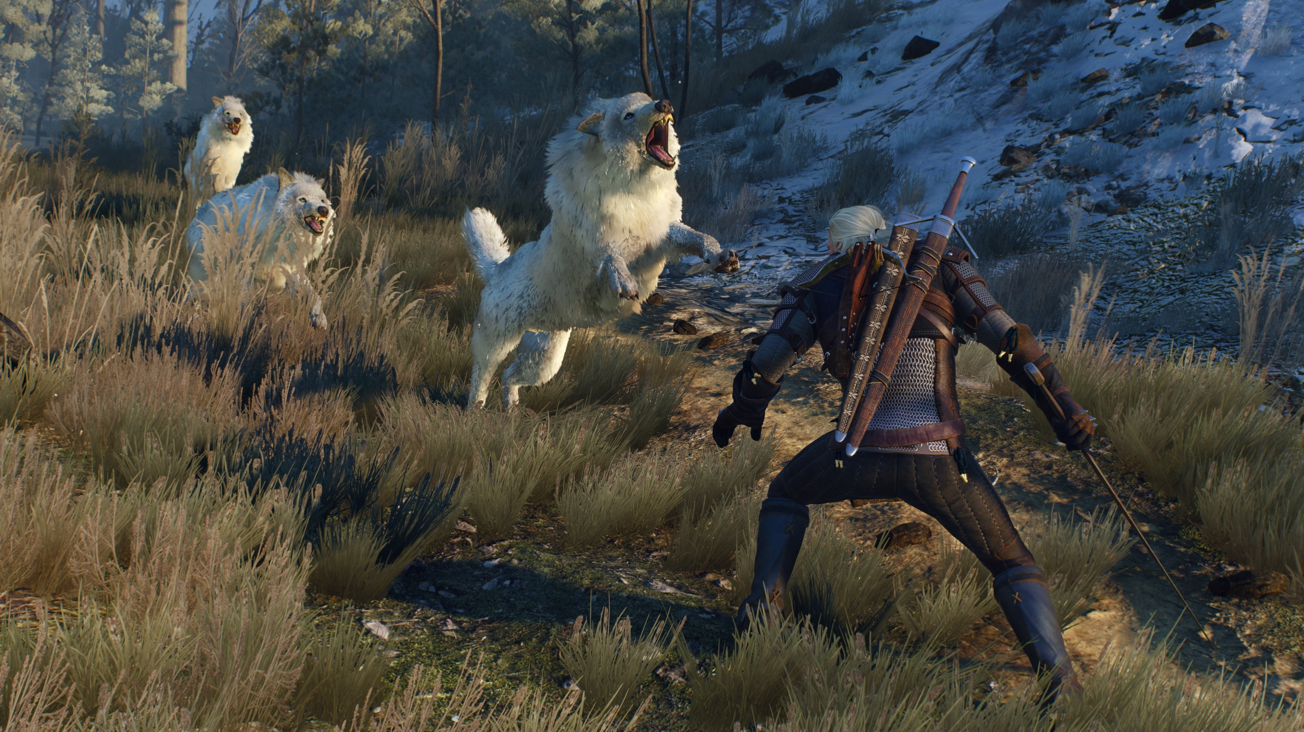
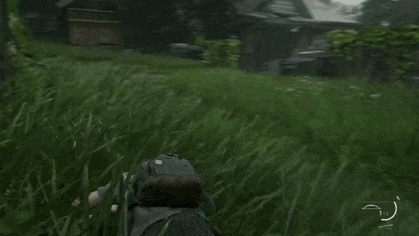
MORE EXAMPLES
Very accurate physics simulation on the left here
No intersections
Out of the scope of this talk

Slide 9
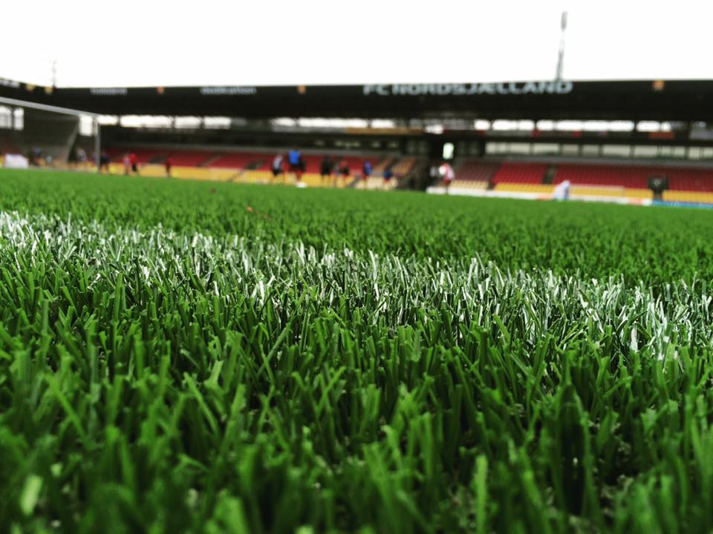
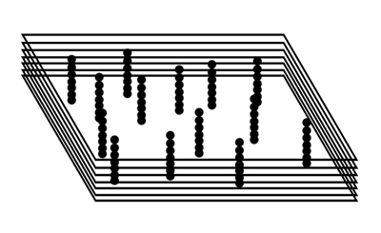
EXAMPLE: Rocket League
[Show video]
Doesn’t interact with anything, minimal animation
Very short
Very dense
Uniform height
Synthetic grass (shiny-looking and artificial-looking pattern), only one model
Not fur shells (https://gamedev.stackexchange.com/questions/103313/how-can-i-implement-a-short-cut-grass-effect)
Looks very convincing (maybe not realistic – but exaggerates all the right qualities)
If you’ve ever been on a soccer field with fake grass – this matches your mental model of what that looks like
Fur shells is a classic technique to render fur
Not that much separates grass from fur
General idea is to stack

Slide 10
BRUTE FORCE GRASS
Quarter-field texture for color (mirrored on X & Y)
Team-specific color stored in alpha channel
Grass texture strip (tiling)
Grid mesh
Extra:
Field divided into squares, rendered one square at a time
Some kind of culling (grass squares too far away aren’t rendered)
Terrain consists of colormap x noise texture

Slide 11
GRASS ANIMATION
Simulating wind
Base wind strength: windStrength = sin(position.x + time) + cos(position.z + time)
Detailed wind strength: windStrength = Scrolling + tiling + multi-layered Perlin noise
Reacting to wind
bendFactor = vertex.y / meshHeight
bendFactor *= bendFactor
windStrength *= bendFactor
vertex.xyz += windDirection.xyz * windStrength
SpeedTree rolling wind feature: https://www.youtube.com/watch?v=gdpJ-akDGdw
Vertex shader
Nice characteristic

Slide 12
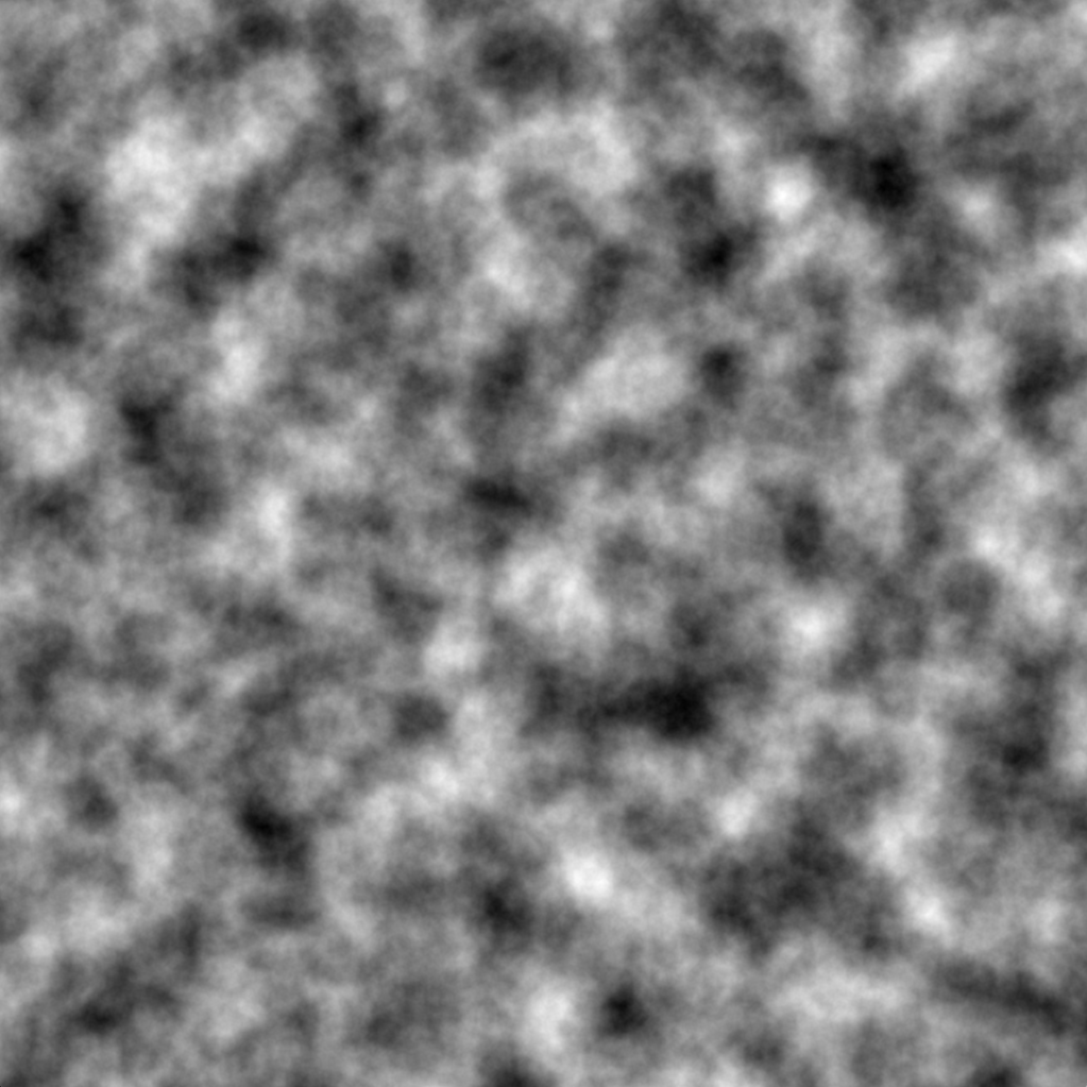
Perlin noise
https://twitter.com/Sam_Makes_Games/status/1309983076714385408
Noise textures – important tool
Perlin noise is just a type of noise with natural-looking features

Slide 13
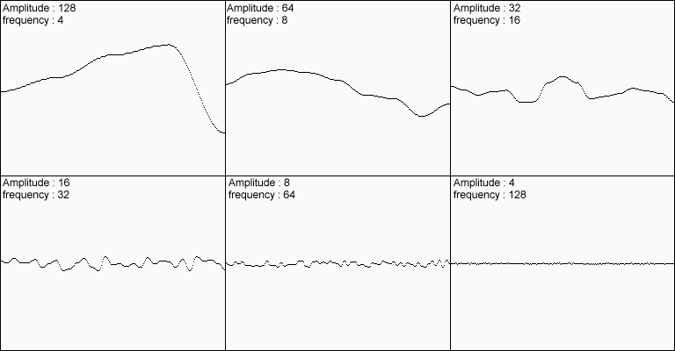
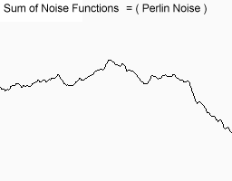
Perlin noise (multi-layered)
The trick to any noise is low-frequency detail + high-frequency detail
Especially makes sense for wind
1D but same applied to 2D

Slide 14
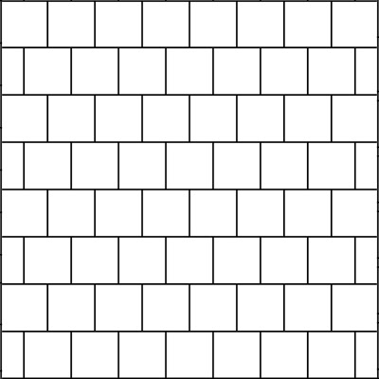
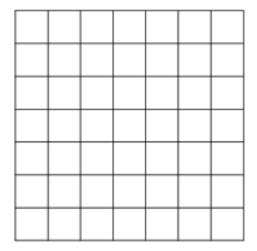
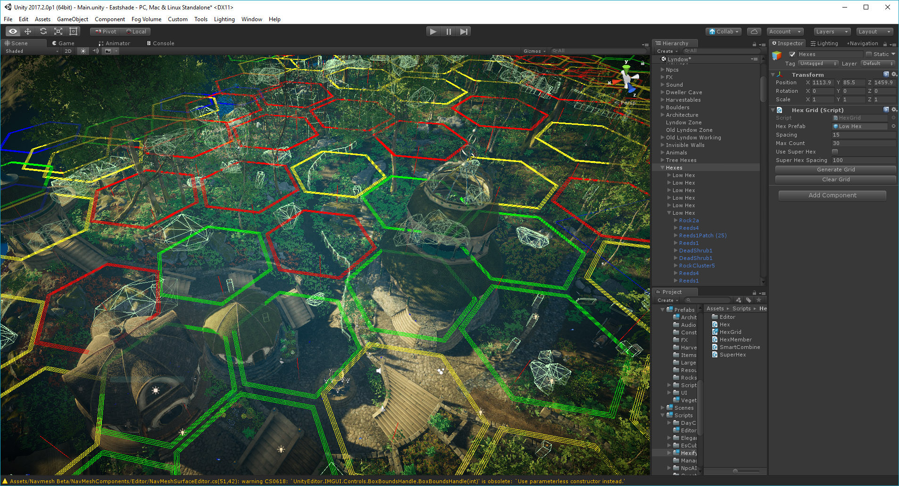
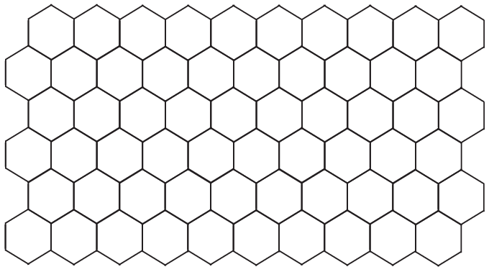
CULLING & Loading
https://twitter.com/Kotaku/status/854003973908561920
Grass is super dense and expensive to keep in memory and render
We only care about grass that is near the camera, the rest might as well not exist
Culling groups of grass instead of each individual piece of grass
Square grid? Staggered squares grid? Hex grid?
Culling (camera view) vs loading (distance)
Loading as a function of distance -> circle of visible objects
Square grid is wasteful at the corners (ex load each neighbor cell) - Aseprite

Slide 15
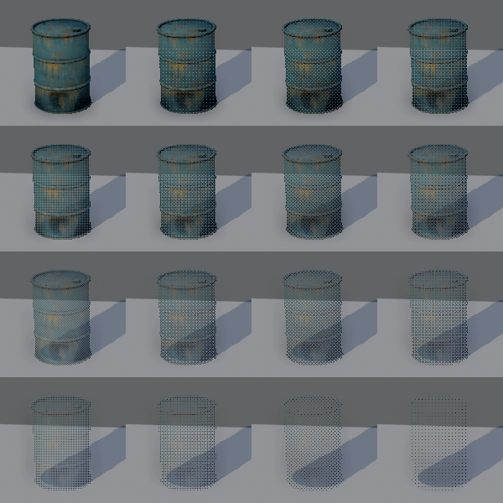
Fade-out
Smooth transition – don’t wanna have a clear line where grass completely disappears
Methods
Transparency
Screen-door transparency (dithering with pattern or noise)
Shrinking
Combination

Slide 16
Interaction
https://twitter.com/minionsart/status/1014226452378775557 - Vertex shader technique (object array)
https://twitter.com/picotanks/status/1094785302810390528 - Render texture technique
https://www.bruteforce-games.com/post/grass-shader-devblog-04 - Same render texture technique

Slide 17
Agricultural simulator 2013
Thinking completely outside of the box, breaking assumptions
Perfectly acceptable for everyone in gaming that grass is only drawn near the player – too expensive otherwise
Grass is a mesh surface, or is it?
Going to first principles
THE ABSOLUTE MADLADS
“The usual approach for rendering grass in the distance requires generating and processing a large amount of geometry or instances, and this consumes a lot of CPU and GPU resources. This approach has been covered in many articles, but its main limitation is that it is not well suited for covering vast amounts of terrain. In order to solve this problem, we considered the question: what does one actually see when they look at grass in the distance? You do not see many individual blades of grass nor any detailed grass movement. What you do see is some general noisy movement, wind patterns, and some grass blades only at boundary regions (where the grass stops and the terrain changes to some other material). From these observations we decided to implement our grass using noise in screen space.”
“The beauty of this technique is that it is extremely cheap, it is very realistic, it does not require any additional resources or preprocessing, it scales beautifully over an entire terrain, and it can extend to vast distances into the scene. It is also very easy to integrate into existing rendering pipelines. This technique does not cover nearby grass rendering, where individual grass fins are actually visible.” – So for nearby grass they still use the classic techniques.

Slide 18
